Slide 1





DST STUIT TRAINING PROGRM
On
“BASIC & ADVANCED TRANSLATIONAL RESEARCH TECHNIQUES”
(23rd - 29th January, 2023 )
ORGANISED BY
Department of Pharmaceutical Science
Rashtrasant Tukadoji Maharaj Nagpur University , Nagpur
IN ASSOCIATION WITH
Jamia Hamdard DST STUTI Project Management Unit
ABOUT DEPARTMENT OF PHARMACEUTICAL SCIENCE
Department of Pharmaceutical Sciences, Rashtrasant Tukadoji Maharaj Nagpur University is a pioneer Pharmaceutical Institution having 66 years of golden history and is being recognized Nationally & Internationally for imparting highest quality education since its establishment in 1956. Till date Department has produced more than 2000 Graduates, 2500 Post Graduates and 300 Ph. D. Students. Recently our University got National Assessment and Accreditation Council (NAAC) Accreditation with ‘A’ Grade. On 15th July our Department has been placed All India Ranking 42 in National Institutional Ranking Framework (NIRF), declared by Ministry of Education, Govt of India for 2022-23, 1st in Vidarbha and 7th in Maharashtra.
ABOUT TRAINING PROGRAME
Proposed hands on training program under the STUTI will focus providing the exposure of on various aspect of “Basic & Advanced Translational Research Techniques” to the Scientist, Postdoctoral student , Doctoral student , Young faculties , Post graduate student . Training which will not only help the participant in their currier but society will benefitted through enhance translation research knowledge, and capacity building.
Eligibility :
Postdoctoral student /Doctoral student /Young faculties /Post graduate student/Scientist
Registration fee :
No registration fee
Seat : 30 Participants only
REGISTRATION DETAILS
Scan to QR CODE
Click on Link for training program
https://docs.google.com/forms/d/1eGm7Q6M_KnQY01YdhKTX-l_MIA1Ed7bCYzcGVbfGWSc/edit
Registration Deadline : 15th Jan 2022

Slide 2
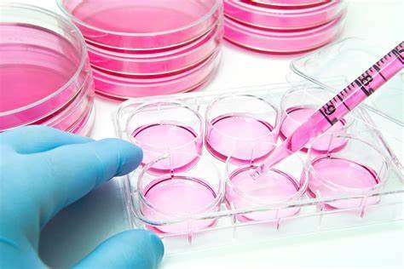
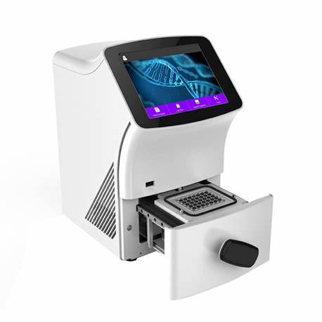
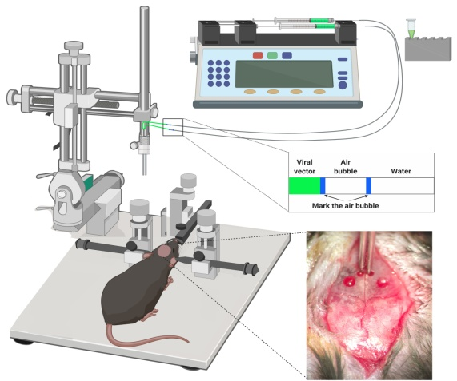
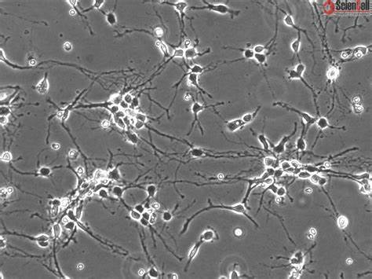
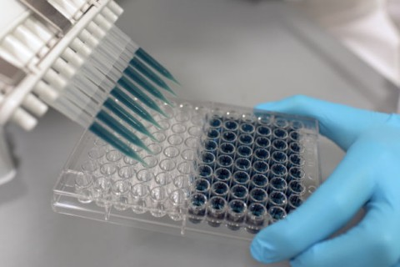
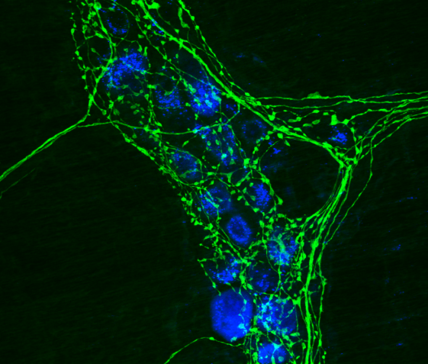

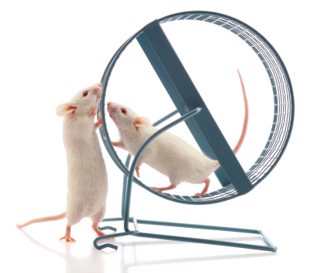
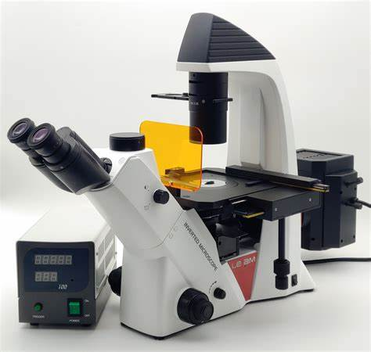
Techniques for Training Module
Enzyme linked Immunosorbant Assay Development
Basic Animal Cell culture techniques
RT PCR: A gateway to futuristic diagnosis
Statistical analsysis
Primary Neuronal cell culture
Immunohistochemistry & Fluorescent microscopy
Stereotaxic neurosurgery
Animal Behavior studies
Microdialysis
HPLC and HPTLC
Flash Chromatography
Invited Speakers
Dr. Rajpal singh Kashyap , CIIMS, Nagpur
Dr. Dadasaheb M. Kokare , Department of Pharmaceutical Sciences, Nagpur University,
Nagpur
Dr. Prakash Rambhau Itankar, Department of Pharmaceutical Sciences, Nagpur University, Nagpur
Dr. Saravana Babu Chidambaram , Jss Mysuru, Nagpur
Dr. Dhananjay Raje, Alpha level consultant (statistics) Nagpur
Dr. Naresh Selokar, NDRI ) Scientist at National Dairy Research Institute, Karnal (Haryana
Dr. Amit Nayak , CIIMS, Nagpur
Dr. Syed Sahadab Raza Era's Lucknow Medical College & Hospital
Dr. Nishikant A. Raut, Department of Pharmaceutical Sciences, Nagpur University, Nagpur
Dr Rajesh Ugale, Department of Pharmaceutical Sciences, Nagpur University, Nagpur
Dr. Brijesh G. Taksande , Smt. Kishoritai Bhoyar College of Pharmacy, Kamptee
Dr. Nilesh M. Mahajan, Dada saheb Balpande College of Pharmacy, Nagpur
Dr. Aliabbas Husain, CIIMS, Nagpur
Organizing team
Dr. Dadasaheb M. Kokare
Email : kokaredada@yahoo.com ; Contact : 98503 18502
Dr. Prakash Rambhau Itankar
Dr. Nishikant A. Raut
Dr. Amit Nayak
Email : amit_ciims@rediffmail.com ; Contact : 9767932938
Dr. Aliabbas Husain
Email : aliabbas_mb@rediffmail.com ; Contact : 97306 48481
Mentors
Dr. Pramod Bhujangrao Khedekar,
Head , Dept. of Phamaceutical sciences , RTM Nagpur University Nagpur
Dr. Lokendra Singh , Director , CIIMS, Nagpur
Dr. Rajpal Singh Kashyap , Director research , CIIMS, Nagpur
ORGANISED BY
Department of Pharmaceutical Science
Rashtrasant Tukadoji Maharaj Nagpur University , Nagpur
Mahatma Jyotiba Fuley Shaikshanik Parisar, Amravati Road,
Nagpur. 440 033

